Slide 1
IoT based automated Biogas System

Slide 2
Problem Statement
Biogas is a potential and beneficial renewable energy source for sustaining rural women’s livelihoods support. Turning manure like sewer, urban waste and cow-dung into biogas is reaping rich rewards for many people not only in urban and rural communities of Bangladesh but around the world. Biogas can be used to supply power to remote villages for lighting, playing small radios and power television sets. Even though biogas is an important alternative fuel power, sometimes it is not popular for some issues such as suddenly reducing gas pressure, scarcity of cow dung etc. These issues can be occered due to prior knowledge and operating problem of assigned gas plant operator.

Slide 3
Here are examples of problems that can affect in production of biogas plant:
Gas yield has dropped
Drop in quality of substrates
Drop of temperature
Compounds inhibition
Non-homogenous substrates
Drop of methanogenic bacteria
Methane concentration dropped
Drop in quality of substrates
Drop of temperature
Compounds inhibition

Slide 4
Here are examples of problems that can affect in production of biogas plant:
Foaming problem
A new substrates with high protein content has been added
Air is introduced in the digestion
Temperature is changing
pH dropped
Feeding rate is too high or variable
Operating temperature have changed
Agitation is not working
An Internet of Things (IoT) technology with mobile apps can be helpful to solve these above problems. By using IoT a Biogas plant can be converted automated mostly.

Slide 5
Objective of the research project:
Developing automated biogas is the important objective of this research. Mobile Apps based remote monitoring system will be the additional part of this research.

Slide 6
Relate with socioeconomic Development
Most important impact is protecting green environment. This will help the villagers in meeting the energy needs. The use of state-of-the-art IoT technology with mobile application in rural areas will erode the role of the present government in the exchange of digital Bangladesh.

Slide 7
Work plan/ time frame Total: Six Months
Task/Month | 1st | 2nd | 3rd | 4th | 5th | 6th
Create Biogas Plant
Mobile Apps Development
IoT implementation
Final Report

Slide 8
Methodology( work procedure of the system)
Step-1: Making Biogas plant with IoT implementation facilities.
Step-2: Developing IoT devices.
Step-3: Connecting biogas plant with local cloud.
Step-4: Developing Mobile Application for monitoring biogas plant

Slide 9
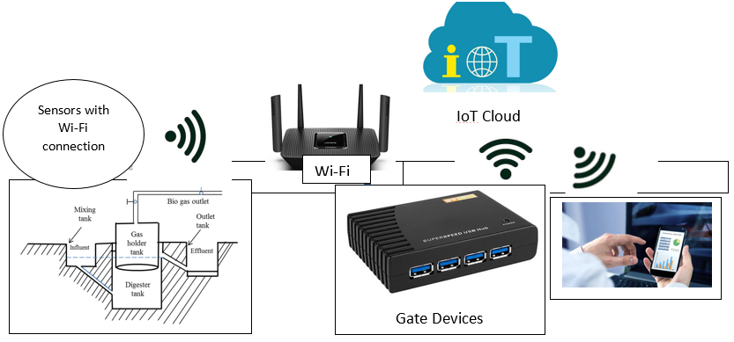
Methodology( work procedure of the system)

Slide 10
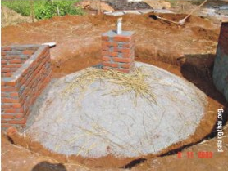
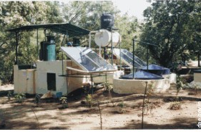
Methodology( work procedure of the system)
Biogas Plant

Slide 11
What outputs from the project can be considered for the assessment of its success?
If the biogas plant will be automated, people can be interested to implement this. This will be helpful to protect our green environment.

